Slide 1


Core Principles of Programming with python
Week 2

Slide 2
Logical Operators
An example of the logical operators in Python:
Logical operators are used to compare two values.
These include:
Equals: a == b
Not Equals a != b
Less than a < b
Less than or equal to a <= b
Greater than a > b
Greater than or equal to: a >= b

Slide 3
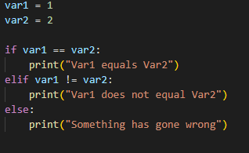
If Statements
If statements are used to run some code but only under the correct conditions.
They can also be used to compare to values.
An example of an IF Statement in Python:
The counterpart to IF statements are else statements.
The best way to look at these are if “something” is happening then I want “this” to happen.
Otherwise, I want something “else” to happen.
Var1
IF
ELSE

Slide 4
Activity
Help
Remember last weeks commands:
print()
input()
int()
Using what you have just learnt,
Create a variable that stores a two digit number.
Create a variable that the user can input an integer into.
Using an IF statement check if the two values equal each other and write an Else statement for if they don’t.

Slide 5
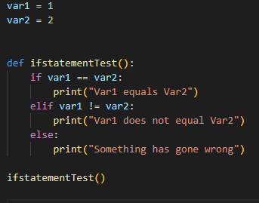
functions
An example of a function in Python:
A function is essentially code that is written outside of the main program as it must be called to run it.
This is extremely useful when you do not want to repeat the same lines of code over and over.
I am now able to run this If statement Test simply by calling it at any point instead of writing the whole If statement again.
Name of the function
“def” keyword creates the function
Parameters for the function

Slide 6
Activity
Help
Python uses indentation as it’s structure so make sure you indent correctly.
“def” is the keyword for creating a function but not calling it.
Make sure to add parentheses to the end of your function name whenever you type it.
Using what you have just learnt,
Place your previous code into a function.

Slide 7
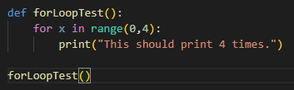

For loops
An example of a for loop in Python:
A for loop is a form of iteration that we use to repeat lines of code a certain number of times consecutively, in contrast to functions that must be called every time you want to use them.
It is like saying “I want to do this FOR this amount of time”.
In Python we generally use For X in range(however many iterations you want) to produce a for loop.
The range of numbers you want to cycle the code through
X acts as a counter for how many times the loop has been run through
Code to be repeated

Slide 8
Activity
Further Activity
Place that for loop into a function so it can be called at any point.
Important function to remember is the range() function.
Also remember to use “in range()”
Using what you have just learnt,
Help
Create a for loop to produce five strings in the console of your favourite songs title.

Slide 9
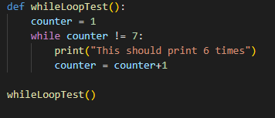
While loops
An example of a while loop in Python:
A while loop is a form of iteration that we use to repeat lines of code a certain number of times consecutively.
In contrast to for loops, while loops will go on until specific conditions are met.
It is like saying “I want to do this WHILE this is happening”.
It is extremely easy to have a while loop go on indefinitely, be sure to meet the while conditions at some point so that the loop stops.
Defining the counter variable
The while condition
Code to be repeated
Making sure the while condition will be fulfilled

Slide 10
Activity
Further Activity
Place that while loop into a function so it can be called at any point.
Important to remember to meet the while condition to make sure it does not go on forever.
Also remember to indent correctly!
Using what you have just learnt,
Help
Create a while loop to produce five strings in the console of your favourite music artists or bands name.

Slide 11

End of week two

